Slide 1
CUT OUT THIS HOLE.
LOOK THROUGH IT.
DRAW THE MOST INTERESTING THING YOU SEE HERE.
Devised by Thomas Tallis School

Slide 2
INVENT A NEW WORD. MAKE SURE YOUR WORD DOESN’T ALREADY EXIST. WRITE IT BELOW WITH ITS DICTIONARY DEFINITION
Devised by Thomas Tallis School

Slide 3

HOW INQUISITIVE HAVE YOU BEEN TODAY?
COLOUR / SHADE IN THE AMOUNT.
CAN YOU FILL UP THE BOTTLE?
Devised by Thomas Tallis School

Slide 4
5 THINGS THAT WOULD MAKE LEARNING AT SCHOOL MORE IMAGINATIVE
1
2
3
4
5
Devised by Thomas Tallis School

Slide 5

Devised by Thomas Tallis School

Slide 6

DESIGN A REWARD FOR SOMEONE WHO HAS MADE EXCELLENT PROGRESS IN DEVELOPING ONE OR MORE OF THE CREATIVE HABITS OF MIND. (NOTE: THE REWARD CAN’T COST MORE THAN 20P TO MAKE) THEN GIVE IT TO SOMEONE
Devised by Thomas Tallis School

Slide 7
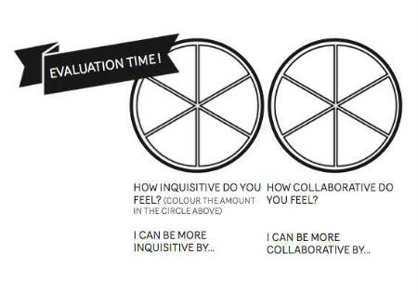
Devised by Thomas Tallis School

Slide 8
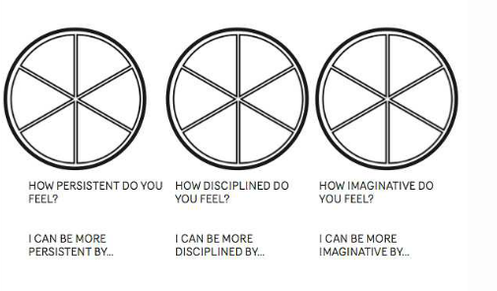
Devised by Thomas Tallis School

Slide 9

Devised by Thomas Tallis School

Slide 10
WRITE A COLLABORATIVE STORY WITH AT LEAST 4 FRIENDS IN WHICH YOU TAKE TURNS TO WRITE A SENTENCE
Devised by Thomas Tallis School

Slide 11
FIND A COIN. EXAMINE IT FOR 30 SECONDS
WRITE FIVE PLACES IT COULD HAVE BEEN BEFORE IT GOT TO YOU.
1
2
3
4
5
Devised by Thomas Tallis School

Slide 12
HOW COLLABORATIVE HAVE YOU BEEN TODAY?
COLOUR / SHADE IN THE AMOUNT.
CAN YOU FILL UP THE BOTTLE?
Devised by Thomas Tallis School

Slide 13
THE WHOLE PURPOSE OF EDUCATION IS TO …
Devised by Thomas Tallis School

Slide 14
HOW PERSISTENT HAVE YOU BEEN TODAY?
COLOUR / SHADE IN THE AMOUNT.
CAN YOU FILL UP THE BOTTLE?
Devised by Thomas Tallis School

Slide 15

1
2
3
4
5
6
7
8
9
10
Devised by Thomas Tallis School

Slide 16
IMAGINE YOU ARE IN CHARGE OF THE EDUCATION SYSTEM. WHAT 5 THINGS WOULD YOU DO TO MAKE IT BETTER FOR LEARNERS?
1
2
3
4
5
Devised by Thomas Tallis School

Slide 17


Devised by Thomas Tallis School

Slide 18
HOW DISCIPLINED HAVE YOU BEEN TODAY?
COLOUR / SHADE IN THE AMOUNT.
CAN YOU FILL UP THE BOTTLE?
Devised by Thomas Tallis School

Slide 19

Devised by Thomas Tallis School

Slide 20

Devised by Thomas Tallis School

Slide 21

Devised by Thomas Tallis School

Slide 22

Devised by Thomas Tallis School

Slide 23
HOW IMAGINATIVE HAVE YOU BEEN TODAY?
COLOUR / SHADE IN THE AMOUNT.
CAN YOU FILL UP THE BOTTLE?
Devised by Thomas Tallis School

Slide 24

Devised by Thomas Tallis School

Slide 25
IN WHICH SUBJECT TO YOU COLLABORATE THE MOST? DESCRIBE ONE ACTIVITY THAT YOU ENJOYED.
Devised by Thomas Tallis School

Slide 26

WRITE A LIST OF INGREDIENTS AND INSTRUCTIONS (LIKE A COOKING RECIPE) TO HELP SOMEONE DEVELOP CREATIVITY.
Devised by Thomas Tallis School

Slide 27

Devised by Thomas Tallis School

